Slide 1
L17. Reinforcement Learning
(Temporal Difference Methods)
SARSA
Q-learning

Slide 2


Introduction
Dynamic Programming (DP) Methods
Monte Carlo (MC) Methods
pros: Update estimates based in part on other learned estimates, without waiting for a final outcome (bootstrap)
pros: Learn directly from raw experience without a model
cons: Need explicit model
cons: Need to wait until the end of episode to observe expected reward
Temporal-Difference (TD) Learning
pros: Learn directly from raw experience without a model
Model free
MC
$$+$$
On line
Incremental
pros: Update estimates based in part on other learned estimates, without waiting for a final outcome (bootstrap)
DP
TD Generalized Policy iteration for
On-Policy TD Control (SARSA)
TD Policy Evaluation
$$+$$
TD Policy Improvement
Off-Policy Q-learning Control

Slide 3
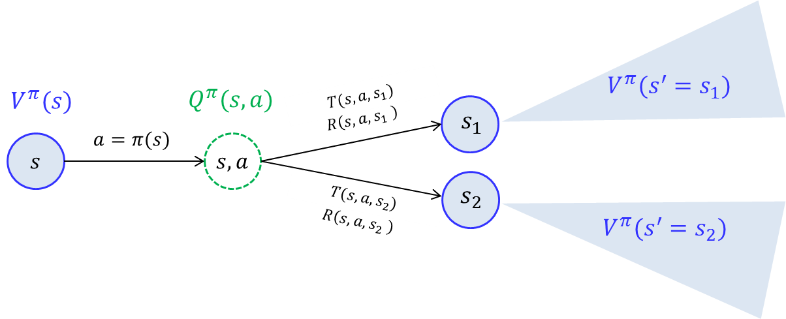
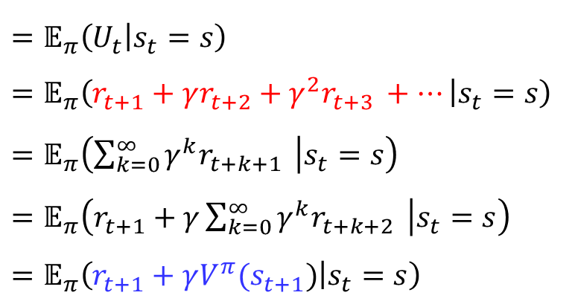

Recall : Value function
$$V^{π}\left(s\right)$$
$$=𝔼_{π}\left(U_{t} | s_{t}=s\right)$$
$$=𝔼_{π}\left(r_{t+1}+γr_{t+2}+γ^{2}r_{t+3 }+… | s_{t}=s\right)$$
$$=𝔼_{π}\left(\sum_{k=0}^{∞}{γ^{k}r_{t+k+1} } | s_{t}=s\right)$$
$$=𝔼_{π}\left(r_{t+1}+γ\sum_{k=0}^{∞}{γ^{k}r_{t+k+2} } | s_{t}=s\right)$$
$$=𝔼_{π}\left(r_{t+1}+γV^{π}(s_{t+1}) | s_{t}=s\right)$$
Complete episode
Bootstrapping

Slide 4
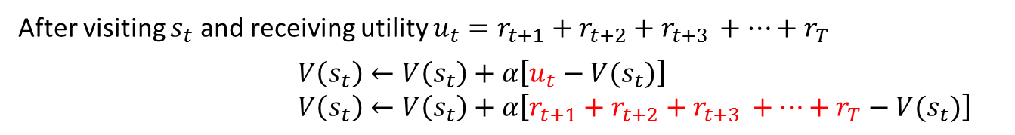
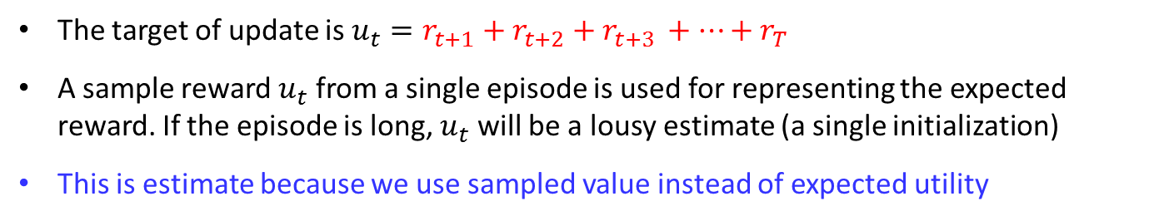
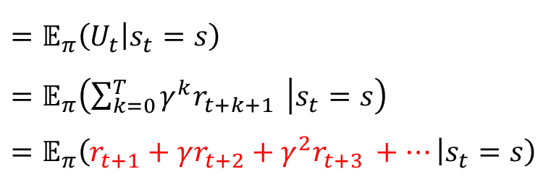

Monte Carlo Policy Evaluation
$$V^{π}\left(s\right)$$
$$=𝔼_{π}\left(U_{t} | s_{t}=s\right)$$
$$=𝔼_{π}\left(\sum_{k=0}^{T}{γ^{k}r_{t+k+1} } | s_{t}=s\right)$$
$$=𝔼_{π}\left(r_{t+1}+γr_{t+2}+γ^{2}r_{t+3 }+… | s_{t}=s\right)$$
A sampled episode
Constant-$α$ MC :
After visiting $s_{t}$ and receiving utility $u_{t}=r_{t+1}+r_{t+2}+r_{t+3 }+…+r_{T}$
$V\left(s_{t}\right)←V\left(s_{t}\right)+α\left[u_{t}−V(s_{t})\right]$
$V\left(s_{t}\right)←V\left(s_{t}\right)+α\left[r_{t+1}+r_{t+2}+r_{t+3 }+…+r_{T}−V(s_{t})\right]$
Target
The target of update is $u_{t}=r_{t+1}+r_{t+2}+r_{t+3 }+…+r_{T}$
A sample reward $u_{t}$ from a single episode is used for representing the expected reward. If the episode is long, $u_{t}$ will be a lousy estimate (a single initialization)
This is estimate because we use sampled value instead of expected utility

Slide 5

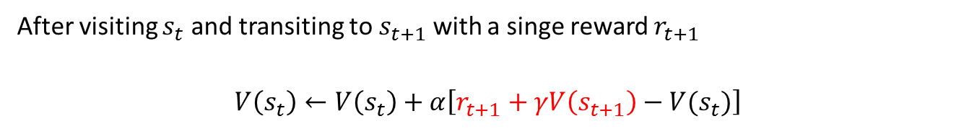
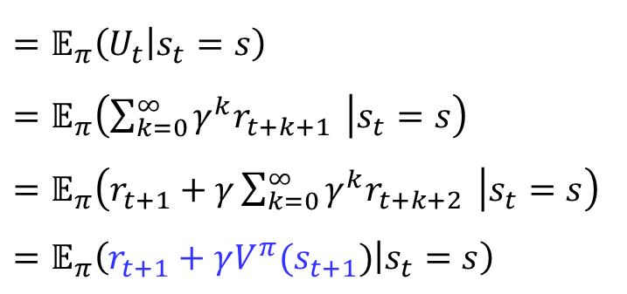
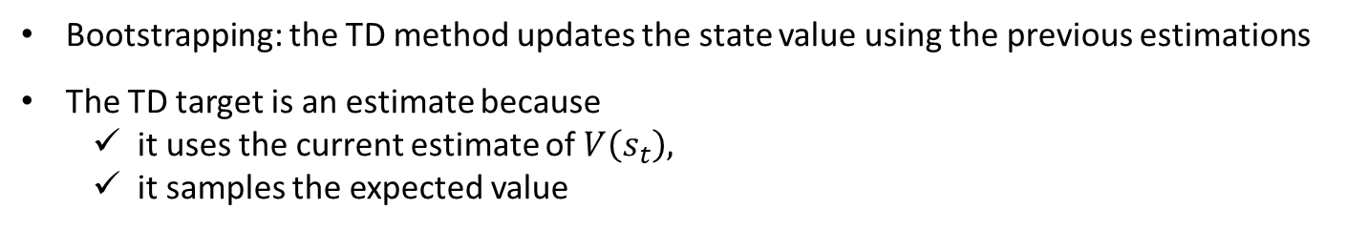
Temporal Difference Policy Evaluation
$$V^{π}\left(s\right)$$
$$=𝔼_{π}\left(U_{t} | s_{t}=s\right)$$
$$=𝔼_{π}\left(\sum_{k=0}^{∞}{γ^{k}r_{t+k+1} } | s_{t}=s\right)$$
$$=𝔼_{π}\left(r_{t+1}+γ\sum_{k=0}^{∞}{γ^{k}r_{t+k+2} } | s_{t}=s\right)$$
$$=𝔼_{π}\left(r_{t+1}+γV^{π}(s_{t+1}) | s_{t}=s\right)$$
Bootstrapping
Temporal Difference Policy Evaluation ;$TD\left(0\right)$:
After visiting $s_{t}$ and transiting to $s_{t+1}$ with a singe reward $r_{t+1}$
$$V\left(s_{t}\right)←V\left(s_{t}\right)+α\left[r_{t+1}+γV\left(s_{t+1}\right)−V(s_{t})\right]$$
Target
Bootstrapping: the TD method updates the state value using the previous estimations
The TD target is an estimate because
it uses the current estimate of $V\left(s_{t}\right),$
it samples the expected value
$$𝔼_{π}\left(r_{t+1}+γV^{π}(s_{t+1}) | s_{t}=s\right)$$

Slide 6


Temporal Difference Policy Evaluation
Algorithm : Tabular $TD\left(0\right)$ for estimating $V^{π}$
Initialize $V\left(s\right)$ arbitrarily, $π$ to the policy to be evaluated
Repeat (for each episode):
Initialize $s$
Repeat (for each step of episode)
$a←$ action given by $π$ for $s$
Take action $a;$ observe reward $r$ and next state $s′$
$V(s)$ $←V\left(s\right)+α\left[r+γV\left(s^{′}\right)−V(s)\right]$
s $←$s’
Until $s$ is terminal
Simple backups (MC method and TD methods) : Use a single sample success state
Recall:
Full Backups (DP approach) : Use complete distribution of all possible successors
$$V^{π}(s)=\sum_{s′}{T(s,π(s),s^{′})\left\{R\left(s,π(s),s^{′}\right)+γV^{π}(s′)\right\}}$$

Slide 7
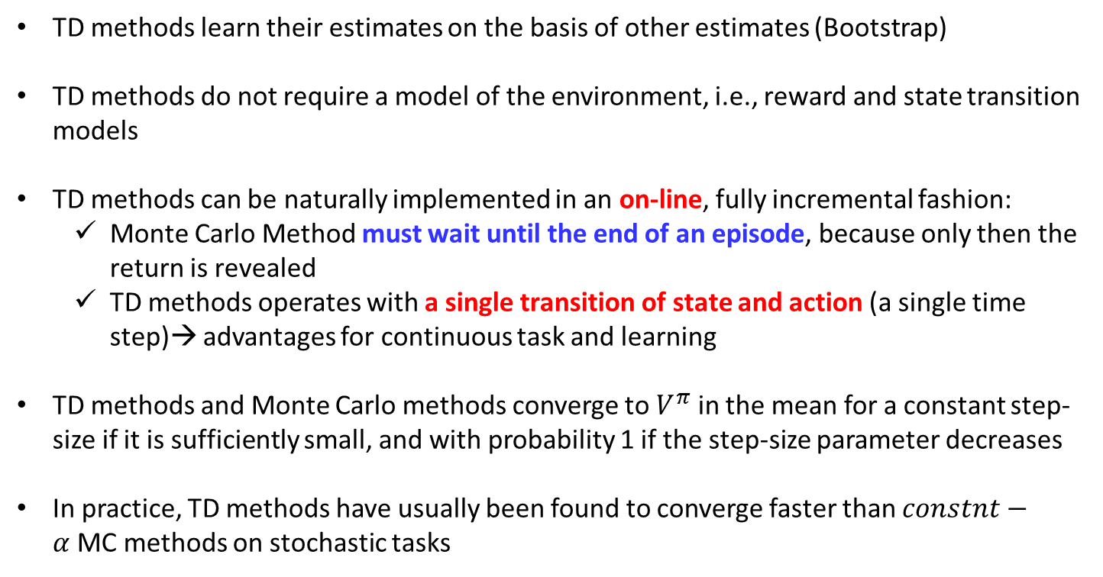
Advantages of TD Policy Evaluation (prediction)
What advantages do TD methods have over Monte Carlo and DP methods?
TD methods learn their estimates on the basis of other estimates (Bootstrap)
TD methods do not require a model of the environment, i.e., reward and state transition models
TD methods can be naturally implemented in an on-line, fully incremental fashion:
Monte Carlo Method must wait until the end of an episode, because only then the return is revealed
TD methods operates with a single transition of state and action (a single time step)→ advantages for continuous task and learning
TD methods and Monte Carlo methods converge to $V^{π}$ in the mean for a constant step-size if it is sufficiently small, and with probability 1 if the step-size parameter decreases
In practice, TD methods have usually been found to converge faster than $constnt−α$MC methods on stochastic tasks

Slide 8




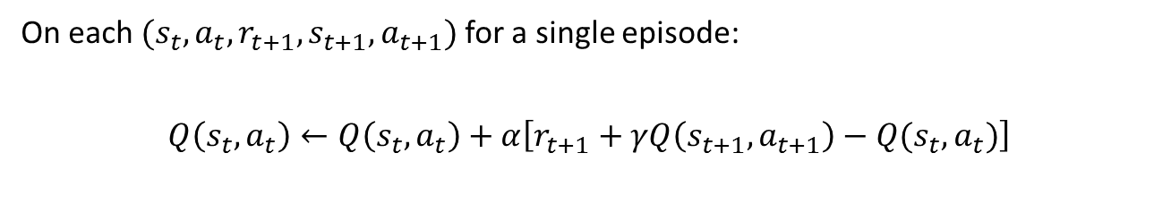




Temporal Difference Policy Evaluation for Q function
As we estimate state value $V\left(s\right)$, we can estimate $Q\left(s,a\right)$ using a TD method
$${ s}_{t}$$
$$r_{t+1}$$
$${ s}_{t+1}$$
$${ s}_{t+2}$$
$${ s}_{t}, a_{t}$$
$${ s}_{t+1}, a_{t+1}$$
$${ s}_{t+2}, a_{t+2}$$
Temporal Difference Policy Evaluation for $Q(s,a)$ function
On each$(s_{t},a_{t},r_{t+1},s_{t+1},a_{t+1})$ for a single episode:
$$Q\left(s_{t},a_{t}\right)←Q\left(s_{t},a_{t}\right)+α\left[r_{t+1}+γQ\left(s_{t+1}, a_{t+1}\right)−Q(s_{t}, a_{t})\right]$$
Note that the action taken is given as data
Target
Current estimate
TD Generalized Policy iteration for
TD Policy Evaluation
$$+$$
TD Policy Improvement
On-Policy TD Control (SARSA)
Off-Policy TD Control (Q-learning)
Estimation and prediction problem
Decision making problems

Slide 9

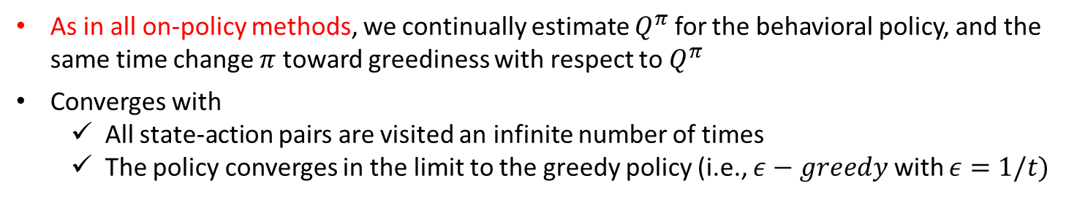
Sarsa: On-Policy TD Control
SARSA Algorithm
Initialize $Q(s,a)$ arbitrarily
Repeat (for each episode):
Initialize $s$
Choose $a$ from $s$ using policy derived from $Q$ (e.g., $ε−greedy$)
Repeat (for each time step of episode):
Take action $a$ given $s$, observe $r$, $s^{′}$
Choose $a′$ from $s′$ using policy derived from $Q$ (e.g., $ε−greedy$)
$Q_{π}\left(s,a\right)←Q_{π}\left(s,a\right)+η\left(r+γQ_{π}\left(s′,a′\right)−Q_{π}\left(s,a\right)\right)$
${s←s}^{′}$; ${a←a}^{′}$;
Until $s$ is terminal
Behavioral policy
Estimation policy
=
As in all on-policy methods, we continually estimate $Q^{π}$ for the behavioral policy, and the same time change $π$ toward greediness with respect to $Q^{π}$
Converges with
All state-action pairs are visited an infinite number of times
The policy converges in the limit to the greedy policy (i.e., $ε−greedy$ with $ε=1/t)$

Slide 10

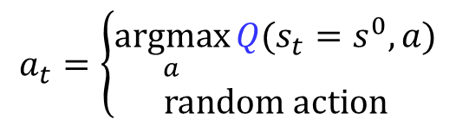


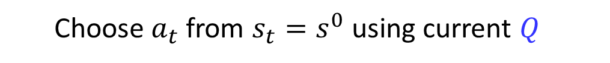










Sarsa: On-Policy TD Control
$$S_{t}$$
$$A_{t}$$
$$R_{t+1}$$
$$S_{t+1}$$
$$A_{t+1}$$
$$S_{t+2}$$
$$a^{1}$$
$$s^{0}$$
$$a^{2}$$
$$a^{3}$$
Choose $a_{t}$ from $s_{t}=s^{0}$ using current $Q$
$$a_{t}=\left\{\begin{aligned}\underset{a}{argmax}{Q(s_{t}=s^{0},a)} \\ random action\end{aligned}\right.$$
with prob $1−ε$
with prob $ε$
Assume $a^{2}$ is chosen

Slide 11













Sarsa: On-Policy TD Control
$$S_{t}$$
$$A_{t}$$
$$R_{t+1}$$
$$S_{t+1}$$
$$A_{t+1}$$
$$S_{t+2}$$
$$s^{1}$$
$$s^{0},a^{1}$$
$$a^{1}$$
$$s^{2}$$
$$r_{t+1}$$
$$s^{1}$$
$$s^{0}$$
$$a^{2}$$
$$s^{0},a^{2}$$
$$a^{3}$$
$$s^{2}$$
$$s^{1}$$
$$s^{0},a^{3}$$
$$s^{2}$$
Take action $a_{t}=a^{2}$ given $s_{t}=s^{0}$ and observe $r_{t+1}$ and $s_{t+1}=s^{1}$

Slide 12







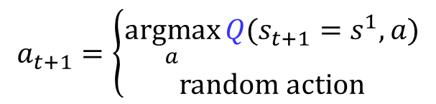





Sarsa: On-Policy TD Control
$$S_{t}$$
$$A_{t}$$
$$R_{t+1}$$
$$S_{t+1}$$
$$A_{t+1}$$
$$S_{t+2}$$
$$s^{1}$$
$$s,a^{1}$$
$$a^{1}$$
$$s^{2}$$
$$s^{1},a^{1}$$
$$a^{1}$$
$$r_{t+1}$$
$$s^{1}$$
$$a^{2}$$
$$s^{1},a^{2}$$
$$s^{0}$$
$$a^{2}$$
$$s,a^{2}$$
$$a^{3}$$
$$s^{2}$$
$${ s}^{1},a^{3}$$
$$a^{3}$$
$$s^{1}$$
$$s,a^{3}$$
$$s^{2}$$
Choose $a_{t+1}$ from $s_{t+1}=s^{1}$ using current $Q$
$$a_{t+1}=\left\{\begin{aligned}\underset{a}{argmax}{Q(s_{t+1}=s^{1},a)} \\ random action\end{aligned}\right.$$
with prob $1−ε$
with prob $ε$
Assume $a^{1}$ is chosen

Slide 13




Sarsa: On-Policy TD Control
$$S_{t}$$
$$A_{t}$$
$$R_{t+1}$$
$$S_{t+1}$$
$$A_{t+1}$$
$$S_{t+2}$$
$$s^{1}$$
$$s^{0},a^{1}$$
Estimation
$$a^{1}$$
$$s^{2}$$
$$s^{1},a^{1}$$
$$Q\left(s^{1}, a^{1}\right)$$
$$a^{1}$$
$$r_{t+1}$$
$$s^{1}$$
$$a^{2}$$
$$s^{1},a^{2}$$
$$s^{0}$$
$$a^{2}$$
$$s^{0},a^{2}$$
$$a^{3}$$
$$s^{2}$$
$${ s}^{1},a^{3}$$
$$a^{3}$$
$$s^{1}$$
$$s^{0},a^{3}$$
$$s^{2}$$
Update $Q$ function with the estimation $Q\left(s_{t+1}, a_{t+1}\right)$
$$Q\left(s_{t},a_{t}\right)←Q\left(s_{t},a_{t}\right)+α\left[r_{t+1}+γQ\left(s_{t+1}, a_{t+1}\right)−Q(s_{t}, a_{t})\right]$$
$$→Q\left(s^{0},a^{2}\right)←Q\left(s^{0},a^{2}\right)+α\left[r_{t+1}+γQ\left(s^{1}, a^{1}\right)−Q(s^{0},a^{2})\right]$$

Slide 14






Sarsa: On-Policy TD Control
$$S_{t}$$
$$A_{t}$$
$$R_{t+1}$$
$$S_{t+1}$$
$$A_{t+1}$$
$$S_{t+2}$$
$$s^{1}$$
$$s,a^{1}$$
$$s^{1}$$
$$a^{1}$$
$$s^{2}$$
$$s^{1},a^{1}$$
$$r_{t+2}$$
$$a^{1}$$
$$s^{2}$$
$$r_{t+1}$$
$$s^{1}$$
$$a^{2}$$
$$s^{1},a^{2}$$
$$s^{0}$$
$$a^{2}$$
$$s,a^{2}$$
$$a^{3}$$
$$s^{2}$$
$${ s}^{1},a^{3}$$
$$a^{3}$$
$$s^{1}$$
$$s,a^{3}$$
$$s^{2}$$
Take action $a_{t+1}=a^{1}$ given $s_{t+1}=s^{1}$ and observe $r_{t+2}$ and $s_{t+2}=s^{2}$

Slide 15

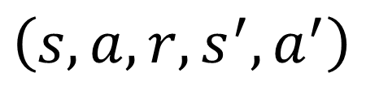

Why Q-learning is considered as Off-Policy method
$$π\left(s\right)$$
$$π\left(s′\right)$$
$$\left(s,a,r,s^{′},a^{′}\right)$$
$$Q\left(s,a\right)←Q\left(s,a\right)+η\left(r+γQ(s^{′},a′)−Q_{π}\left(s,a\right)\right)$$

Slide 16

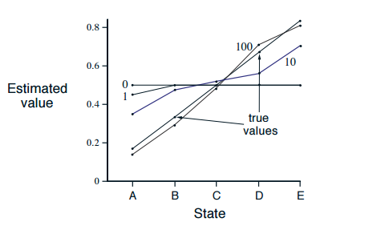
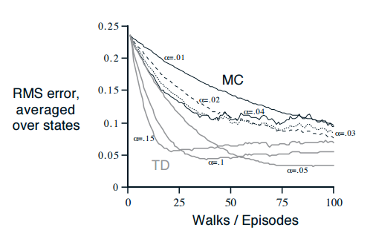
Sarsa: On-Policy TD Control : Windy Grid world Example
A small Markov process for generating random walk

Slide 17
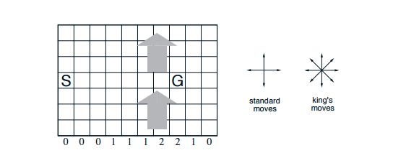
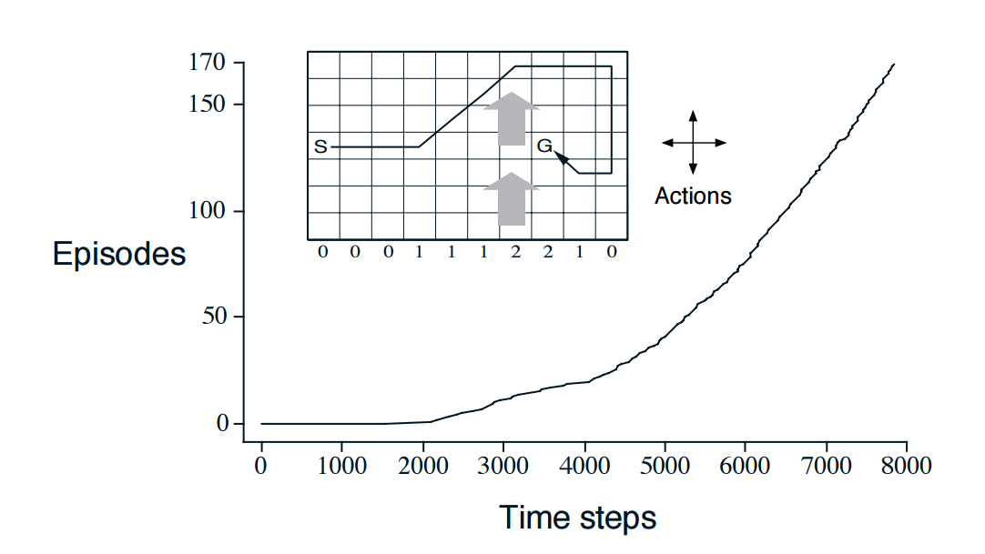
Sarsa: On-Policy TD Control : Windy Grid world Example
State transition is encoded by this figure
Optimal policy

Slide 18

Classification of RL
How to estimate $V^{∗}(s)$ and $Q^{∗}(s,a)$
Monte Carlo method
Temporal Difference methods
Non-Bootstrap
Bootstrap
On-policy
On-policy
Monte Carlo Control
SARSA
How to
explore ?
Off-policy
Off-policy
Monte Carlo Control
Q-Learning
(SARSmaxA)
Episodic based
Single-data-point based

Slide 19
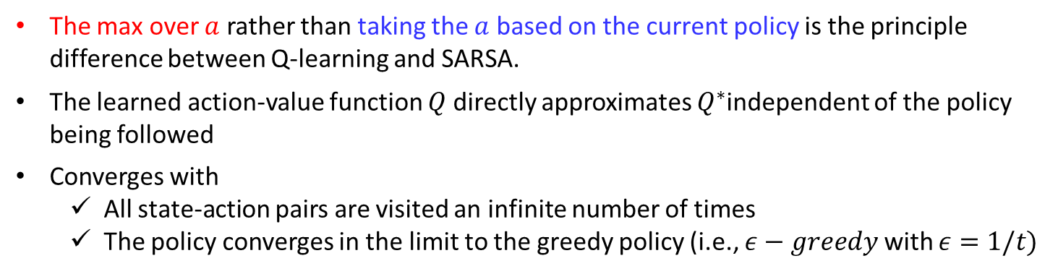
Q-Learning: Off-Policy TD Control
On-Policy TD Control (SARSA)
Choose $a′$ from $s′$ using policy derived from $Q$ (e.g., $ε−greedy$)
$$Q\left(s,a\right)←Q\left(s,a\right)+η\left(r+γQ\left(s′,a′\right)−Q\left(s,a\right)\right)$$
Off-Policy TD Control (Q-learning)
$$Q\left(s,a\right)←Q\left(s,a\right)+η\left(r+γ\max_{a^{′}}{Q\left(s′,a′\right)}−Q\left(s,a\right)\right)$$
The max over $a$ rather than taking the $a$ based on the current policy is the principle difference between Q-learning and SARSA.
The learned action-value function $Q$ directly approximates $Q^{∗}$independent of the policy being followed
Converges with
All state-action pairs are visited an infinite number of times
The policy converges in the limit to the greedy policy (i.e., $ε−greedy$ with $ε=1/t)$

Slide 20

Q-Learning: Off-Policy TD Control
Q learning
Initialize $Q(s,a)$ arbitrarily
Repeat (for each episode):
Initialize $s$
Repeat (for each time step of episode):
Choose $a$ from $s$ using policy derived from $Q$ (e.g., $ε−greedy$)
Take action $a$, observe $r$, $s′$
$Q\left(s,a\right)←Q\left(s,a\right)+η\left(r+γ\max_{a^{′}}{Q\left(s^{′},a′\right)}−Q\left(s,a\right)\right)$
${s←s}^{′}$
Until $s$ is terminal
Behavioral policy
Estimation policy
(Always try to estimate the optimal policy)
-Estimation can be greedy)
$a^{∗}=\underset{a^{′}}{argmax}{Q\left(s′,a\right)}$ is not used in the next state!!!
At the next state $s′,$ Choose $a$ using policy derived from $Q$ (e.g., $ε−greedy$)

Slide 21



Q-Learning: Off-Policy TD Control
$$S_{t}$$
$$A_{t}$$
$$R_{t+1}$$
$$S_{t+1}$$
max$A_{t+1}$
$$S_{t+2}$$
$$a^{1}$$
$$s^{0}$$
$$a^{2}$$
$$a^{3}$$
Choose $a_{t}$ from $s_{t}=s^{0}$ using current $Q$
$$a_{t}=\left\{\begin{aligned}\underset{a}{argmax}{Q(s_{t}=s^{0},a)} \\ random action\end{aligned}\right.$$
with prob $1−ε$
with prob $ε$
Assume $a^{2}$ is chosen

Slide 22
Q-Learning: Off-Policy TD Control
$$S_{t}$$
$$A_{t}$$
$$R_{t+1}$$
$$S_{t+1}$$
max$A_{t+1}$
$$S_{t+2}$$
$$s^{1}$$
$$s^{0},a^{1}$$
$$a^{1}$$
$$s^{2}$$
$$r_{t+1}$$
$$s^{1}$$
$$s^{0}$$
$$a^{2}$$
$$s^{0},a^{2}$$
$$a^{3}$$
$$s^{2}$$
$$s^{1}$$
$$s^{0},a^{3}$$
$$s^{2}$$
Take action $a_{t}=a^{2}$ given $s_{t}=s^{0}$ and observe $r_{t+1}$ and $s_{t+1}=s^{1}$

Slide 23



Q-Learning: Off-Policy TD Control
$$S_{t}$$
$$A_{t}$$
$$R_{t+1}$$
$$S_{t+1}$$
max$A_{t+1}$
$$S_{t+2}$$
$$s^{1}$$
$$s^{0},a^{1}$$
$$a^{1}$$
$$s^{2}$$
$$s^{1},a^{1}$$
$$max$$
$$r_{t+1}$$
$$s^{1}$$
$$s^{1},a^{2}$$
$$\max_{a^{′}}{Q\left(s^{1},a^{′}\right)}$$
$$s^{0}$$
$$a^{2}$$
$$s^{0},a^{2}$$
$$s^{2}$$
$${ s}^{1},a^{3}$$
$$a^{3}$$
$$s^{1}$$
For Estimation policy
$$s^{0},a^{3}$$
$$s^{2}$$
Update $Q$ function with the $\max_{a^{′}}{Q\left(s^{1},a′\right)}$
$$Q\left(s_{t},a_{t}\right)←Q\left(s_{t},a_{t}\right)+α\left[r_{t+1}+γ\max_{a^{′}}{Q\left(s,a′\right)}−Q(s_{t}, a_{t})\right]$$
$$→Q\left(s^{0},a^{2}\right)←Q\left(s^{0},a^{2}\right)+α\left[r_{t+1}+γ\max_{a′}{Q\left(s^{1},a′\right)}−Q(s^{0},a^{2})\right]$$

Slide 24

Q-Learning: Off-Policy TD Control
$$S_{t}$$
$$A_{t}$$
$$R_{t+1}$$
$$S_{t+1}$$
max$A_{t+1}$
$$S_{t+2}$$
$$s^{1}$$
$$s,a^{1}$$
$$a^{1}$$
$$s^{2}$$
$$s^{1},a^{1}$$
$$a^{1}$$
$$r_{t+1}$$
$$s^{1}$$
$$a^{2}$$
$$s^{1},a^{2}$$
$$s^{0}$$
$$a^{2}$$
$$s,a^{2}$$
$$a^{3}$$
$$s^{2}$$
$${ s}^{1},a^{3}$$
$$a^{3}$$
$$s^{1}$$
For Behavioral policy
$$s,a^{3}$$
$$s^{2}$$
Choose $a_{t+1}$ from $s_{t+1}=s^{1}$ using current $Q$
$$a_{t+1}=\left\{\begin{aligned}\underset{a}{argmax}{Q(s_{t+1}=s^{1},a)} \\ random action\end{aligned}\right.$$
with prob $1−ε$
with prob $ε$
Assume $a^{1}$ is chosen

Slide 25
Q-Learning: Off-Policy TD Control
$$S_{t}$$
$$A_{t}$$
$$R_{t+1}$$
$$S_{t+1}$$
max$A_{t+1}$
$$S_{t+2}$$
$$s^{1}$$
$$s,a^{1}$$
$$s^{1}$$
$$a^{1}$$
$$s^{2}$$
$$s^{1},a^{1}$$
$$r_{t+2}$$
$$a^{1}$$
$$s^{2}$$
$$r_{t+1}$$
$$s^{1}$$
$$a^{2}$$
$$s^{1},a^{2}$$
$$s^{0}$$
$$a^{2}$$
$$s,a^{2}$$
$$a^{3}$$
$$s^{2}$$
$${ s}^{1},a^{3}$$
$$a^{3}$$
$$s^{1}$$
$$s,a^{3}$$
$$s^{2}$$
Take action $a_{t+1}=a^{1}$ given $s_{t+1}=s^{1}$ and observe $r_{t+2}$ and $s_{t+2}=s^{2}$

Slide 26
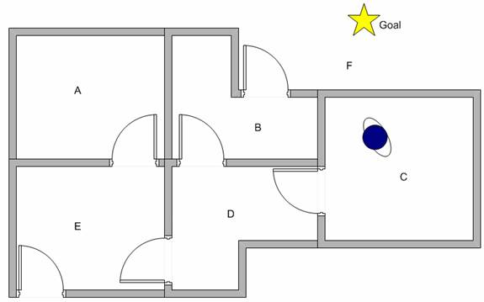

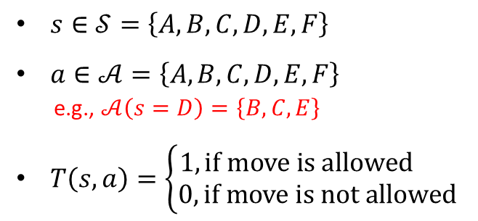


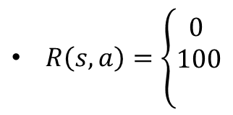


Q-learning Step-by-Step Example
The agent can pass one room to another but has no knowledge of the building
That is, it does not know which sequence of doors the agent must pass to go outside the building
Assume the agent is now in room C, and would like to reach outside the building (state F)
$MDP=\{𝒮,𝒜$, $T,R,γ\}$
$s∈𝒮=\left\{A,B,C,D,E,F\right\}$
$a∈𝒜=\left\{A,B,C,D,E,F\right\}$
e.g., $𝒜\left(s=D\right)=\left\{B,C,E\right\}$
$T\left(s,a\right)=\left\{\begin{aligned}1, if move is allowed \\ 0, if move is not allowed\end{aligned}\right.$
e.g., $T\left(C,D\right)=1$
$R\left(s,a\right)=\left\{\begin{aligned}0 \\ 100 \\ \end{aligned}\right.$
$$\text{if} \text{move} \text{to} a \text{is} \text{allowed} \text{and} a≠F$$
$\text{if} \text{move}$ to $a$ is allowed and $a=F$
$γ=0.8$
Example from: http://people.revoledu.com/kardi/tutorial/ReinforcementLearning/Q-Learning-Example.htm

Slide 27







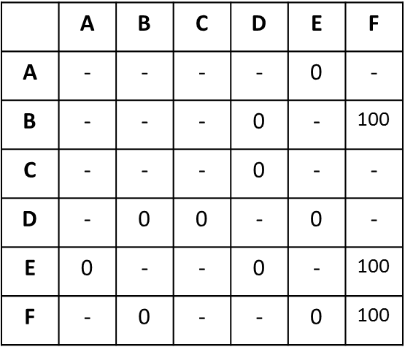



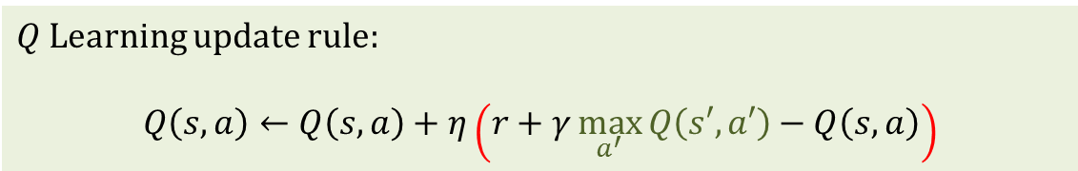
Q-learning Step-by-Step Example
$$a$$
A
B
 | A | B | C | D | E | F
A | - | - | - | - | 0 | -
B | - | - | - | 0 | - | 100
C | - | - | - | 0 | - | -
D | - | 0 | 0 | - | 0 | -
E | 0 | - | - | 0 | - | 100
F | - | 0 | - | - | 0 | 100
$$s$$
$$100$$
$$0$$
F
C
$$R\left(s,a\right)=$$
$$0$$
$$0$$
$$100$$
$$0$$
E
D
$$0$$
$Q$ Learning update rule:
$$Q\left(s,a\right)←Q\left(s,a\right)+η\left(r+γ\max_{a^{′}}{Q\left(s′,a′\right)}−Q\left(s,a\right)\right)$$

Slide 28
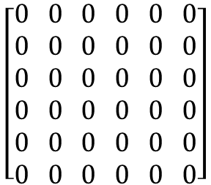








Q-learning Step-by-Step Example
$Q$ Learning update rule: $Q\left(s,a\right)←Q\left(s,a\right)+η\left(r+γ\max_{a}{Q\left(s′,a\right)}−Q\left(s,a\right)\right)$
A
B
$$A B C D E F$$
$$\begin{aligned}A \\ B \\ C \\ D \\ E \\ F\end{aligned}$$
$$\left[\begin{aligned}0 \\ 0 \\ 0 \\ 0 \\ 0 \\ 0\end{aligned}\begin{aligned}0 \\ 0 \\ 0 \\ 0 \\ 0 \\ 0\end{aligned}\begin{aligned}0 \\ 0 \\ 0 \\ 0 \\ 0 \\ 0\end{aligned} \begin{aligned}0 \\ 0 \\ 0 \\ 0 \\ 0 \\ 0\end{aligned} \begin{aligned}0 \\ 0 \\ 0 \\ 0 \\ 0 \\ 0\end{aligned} \begin{aligned}0 \\ 0 \\ 0 \\ 0 \\ 0 \\ 0\end{aligned}\right]$$
$$100$$
$$0$$
F
$$0$$
C
$$Q(s,a)=$$
$$0$$
$$0$$
$$100$$
$$0$$
E
D
$$0$$

Slide 29
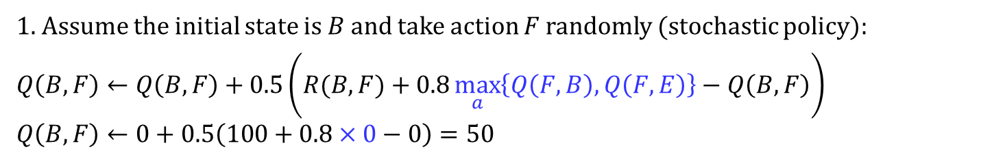

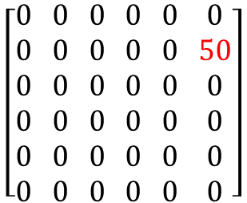
Q-learning Step-by-Step Example
$Q$ Learning update rule: $Q\left(s,a\right)←Q\left(s,a\right)+η\left(r+γ\max_{a}{Q\left(s′,a\right)}−Q\left(s,a\right)\right)$
A
B
$$A B C D E F$$
$$\begin{aligned}A \\ B \\ C \\ D \\ E \\ F\end{aligned}$$
$$\left[\begin{aligned}0 \\ 0 \\ 0 \\ 0 \\ 0 \\ 0\end{aligned}\begin{aligned}0 \\ 0 \\ 0 \\ 0 \\ 0 \\ 0\end{aligned}\begin{aligned}0 \\ 0 \\ 0 \\ 0 \\ 0 \\ 0\end{aligned} \begin{aligned}0 \\ 0 \\ 0 \\ 0 \\ 0 \\ 0\end{aligned} \begin{aligned}0 \\ 0 \\ 0 \\ 0 \\ 0 \\ 0\end{aligned} \begin{aligned}0 \\ 50 \\ 0 \\ 0 \\ 0 \\ 0\end{aligned}\right]$$
$$100$$
$$0$$
F
$$0$$
C
$$Q(s,a)=$$
$$0$$
$$0$$
$$100$$
$$0$$
E
D
$$0$$
1. Assume the initial state is $B$ and take action $F$ randomly (stochastic policy):
$$Q\left(B,F\right)←Q\left(B,F\right)+0.5\left(R(B,F)+0.8\max_{a}\left\{Q\left(F,B\right),Q\left(F,E\right)\right\}−Q\left(B,F\right)\right)$$
$$Q\left(B,F\right)←0+0.5\left(100+0.8×0−0\right)=50$$
2. Because the state $F$ is the final state, the episode is over

Slide 30
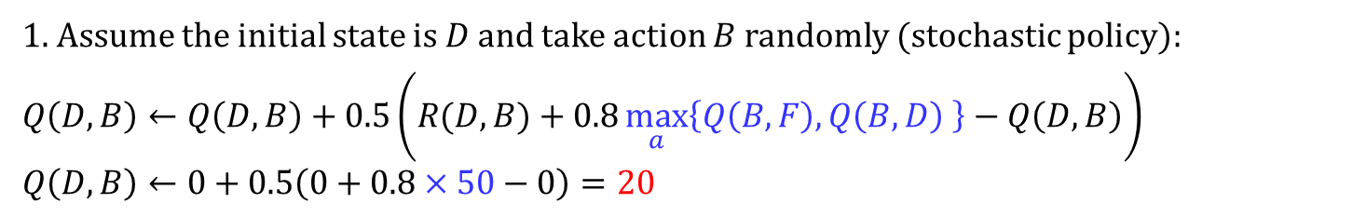
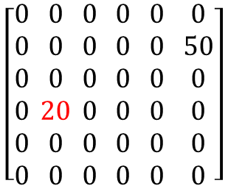


Q-learning Step-by-Step Example
$Q$ Learning update rule: $Q\left(s,a\right)←Q\left(s,a\right)+η\left(r+γ\max_{a}{Q\left(s′,a\right)}−Q\left(s,a\right)\right)$
A
B
$$A B C D E F$$
$$\begin{aligned}A \\ B \\ C \\ D \\ E \\ F\end{aligned}$$
$$\left[\begin{aligned}0 \\ 0 \\ 0 \\ 0 \\ 0 \\ 0\end{aligned}\begin{aligned}0 \\ 0 \\ 0 \\ 20 \\ 0 \\ 0\end{aligned}\begin{aligned}0 \\ 0 \\ 0 \\ 0 \\ 0 \\ 0\end{aligned} \begin{aligned}0 \\ 0 \\ 0 \\ 0 \\ 0 \\ 0\end{aligned} \begin{aligned}0 \\ 0 \\ 0 \\ 0 \\ 0 \\ 0\end{aligned} \begin{aligned}0 \\ 50 \\ 0 \\ 0 \\ 0 \\ 0\end{aligned}\right]$$
$$100$$
$$0$$
F
$$0$$
C
$$Q(s,a)=$$
$$0$$
$$0$$
$$100$$
$$0$$
E
D
$$0$$
1. Assume the initial state is $D$ and take action $B$ randomly (stochastic policy):
$$Q\left(D,B\right)←Q\left(D,B\right)+0.5\left(R(D,B)+0.8\max_{a}\left\{Q\left(B,F\right),Q\left(B,D\right) \right\}−Q\left(D,B\right)\right)$$
$$Q\left(D,B\right)←0+0.5\left(0+0.8×50−0\right)=20$$
$$50$$
$$0$$

Slide 31

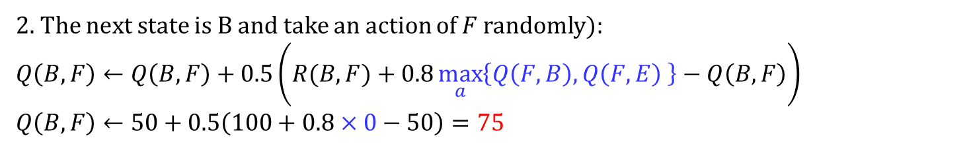

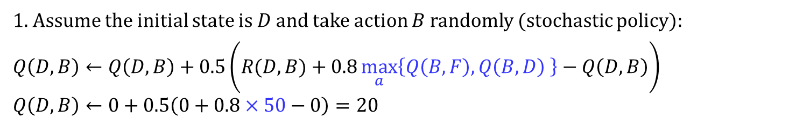
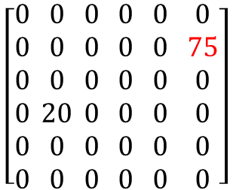
Q-learning Step-by-Step Example
$Q$ Learning update rule: $Q\left(s,a\right)←Q\left(s,a\right)+η\left(r+γ\max_{a}{Q\left(s′,a\right)}−Q\left(s,a\right)\right)$
A
B
$$A B C D E F$$
$$\begin{aligned}A \\ B \\ C \\ D \\ E \\ F\end{aligned}$$
$$\left[\begin{aligned}0 \\ 0 \\ 0 \\ 0 \\ 0 \\ 0\end{aligned}\begin{aligned}0 \\ 0 \\ 0 \\ 20 \\ 0 \\ 0\end{aligned}\begin{aligned}0 \\ 0 \\ 0 \\ 0 \\ 0 \\ 0\end{aligned} \begin{aligned}0 \\ 0 \\ 0 \\ 0 \\ 0 \\ 0\end{aligned} \begin{aligned}0 \\ 0 \\ 0 \\ 0 \\ 0 \\ 0\end{aligned} \begin{aligned}0 \\ 75 \\ 0 \\ 0 \\ 0 \\ 0\end{aligned}\right]$$
$$100$$
$$0$$
F
$$0$$
C
$$Q(s,a)=$$
$$0$$
$$0$$
$$100$$
$$0$$
E
D
$$0$$
1. Assume the initial state is $D$ and take action $B$ randomly (stochastic policy):
$$Q\left(D,B\right)←Q\left(D,B\right)+0.5\left(R(D,B)+0.8\max_{a}\left\{Q\left(B,F\right),Q\left(B,D\right) \right\}−Q\left(D,B\right)\right)$$
$$Q\left(D,B\right)←0+0.5\left(0+0.8×50−0\right)=20$$
$$50$$
$$0$$
2. The next state is B and take an action of $F$ randomly):
$$Q\left(B,F\right)←Q\left(B,F\right)+0.5\left(R(B,F)+0.8\max_{a}\left\{Q\left(F,B\right),Q\left(F,E\right) \right\}−Q\left(B,F\right)\right)$$
$$Q\left(B,F\right)←50+0.5\left(100+0.8×0−50\right)=75$$
$$0$$
$$0$$
3. Because the state $F$ is the final state, the episode is over

Slide 32
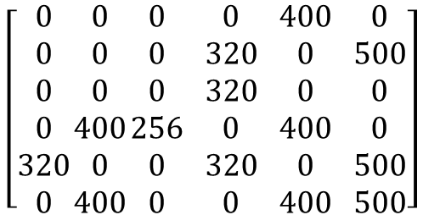



Q-learning Step-by-Step Example
$Q$ Learning update rule: $Q\left(s,a\right)←Q\left(s,a\right)+η\left(r+γ\max_{a}{Q\left(s′,a\right)}−Q\left(s,a\right)\right)$
A
B
$$A B C D E F$$
$$100$$
$$\begin{aligned}A \\ B \\ C \\ D \\ E \\ F\end{aligned}$$
$$\left[\begin{aligned}0 \\ 0 \\ 0 \\ 0 \\ 320 \\ 0\end{aligned}\begin{aligned}0 \\ 0 \\ 0 \\ 400 \\ 0 \\ 400\end{aligned}\begin{aligned}0 \\ 0 \\ 0 \\ 256 \\ 0 \\ 0\end{aligned} \begin{aligned}0 \\ 320 \\ 320 \\ 0 \\ 320 \\ 0\end{aligned} \begin{aligned}400 \\ 0 \\ 0 \\ 400 \\ 0 \\ 400\end{aligned} \begin{aligned}0 \\ 500 \\ 0 \\ 0 \\ 500 \\ 500\end{aligned}\right]$$
$$0$$
$$0$$
F
$$0$$
C
$$0$$
$$Q^{∗}(s,a)=$$
$$0$$
$$100$$
$$0$$
E
D
$$0$$
After convergence
Start

Slide 33
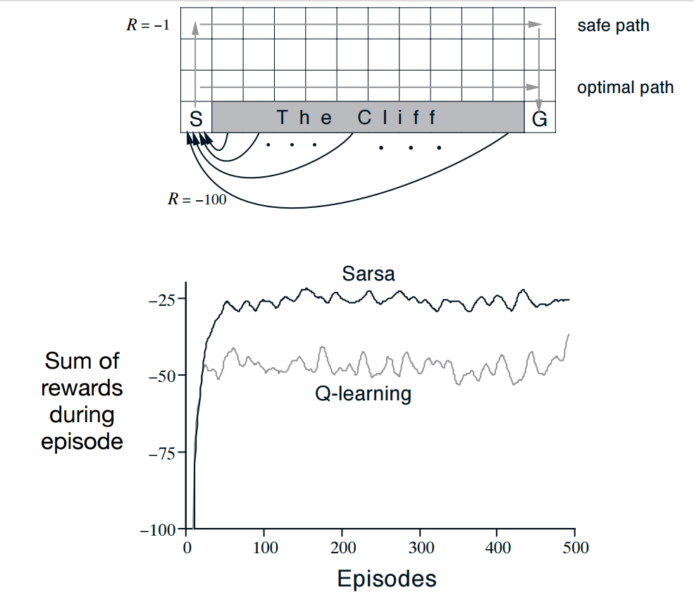
Example 6.6 Cliff Walking
The path away from the cliff
Take longer
A wrong action will not hurt you as much
walk near the cliff
Faster
a wrong action deterministically causes falling off the cliff.
Sarsa learns about a policy that sometimes takes optimal actions (as estimated) and sometimes explores other actions (Estimation policy = Behavioral policy)
Sarsa will learn to be careful in an environment where exploration is costly
Q-learning learns about the policy that doesn't explore and only takes optimal (as estimated) actions
The optimal policy does not capture the risk of exploratory action
The cliff example shows why such a non-optimal policy could be sometimes very useful

Slide 34
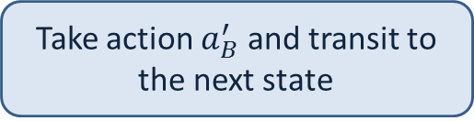
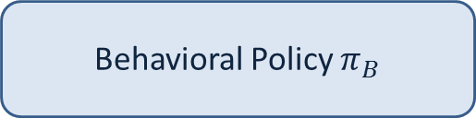
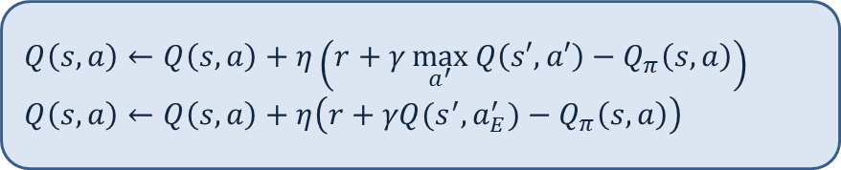
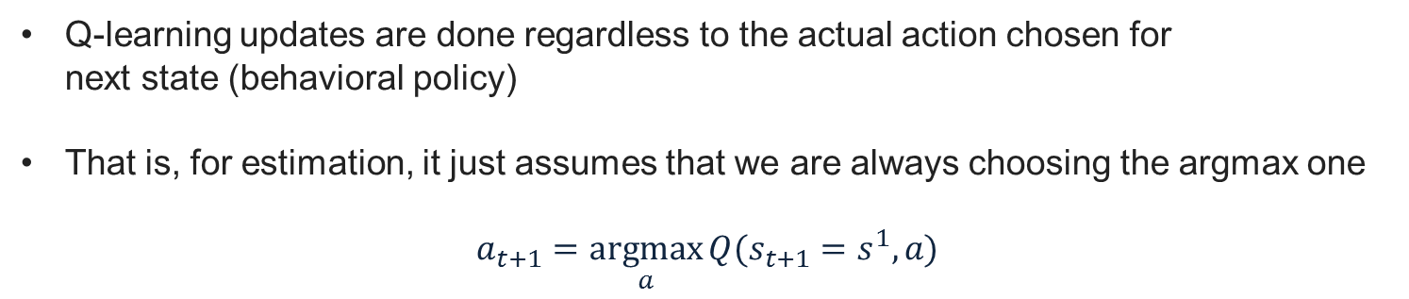
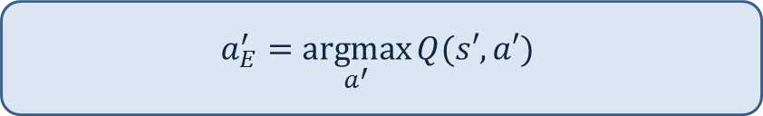
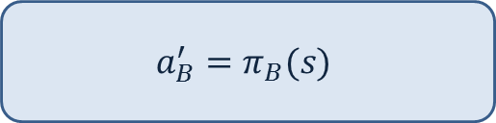

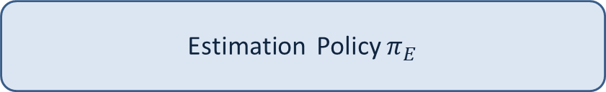

Why Q-learning is considered as Off-Policy method
Q-learning updates are done regardless to the actual action chosen for next state (behavioral policy)
That is, for estimation, it just assumes that we are always choosing the argmax one
$$a_{t+1}=\underset{a}{argmax}{Q(s_{t+1}=s^{1},a)}$$
Behavioral Policy $π_{B}$
Estimation Policy $π_{E}$
$$a_{B}^{′}=π_{B}(s)$$
$$≠$$
$$a_{E}^{′}=\underset{a^{′}}{argmax}{Q(s′,a′)}$$
Used to generated data
Used to estimate $Q\left(s,a\right)$
Take action $a_{B}^{′}$ and transit to the next state
$$Q\left(s,a\right)←Q\left(s,a\right)+η\left(r+γ\max_{a^{′}}{Q\left(s′,a′\right)}−Q_{π}\left(s,a\right)\right)$$
$$Q\left(s,a\right)←Q\left(s,a\right)+η\left(r+γQ(s^{′},a_{E}^{′})−Q_{π}\left(s,a\right)\right)$$

Slide 35
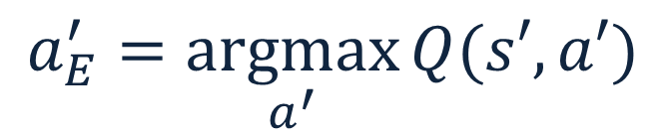


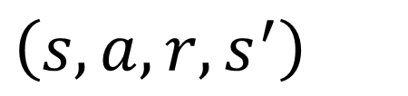

Why Q-learning is considered as Off-Policy method
Change to the stochastic policy
$$π\left(s\right)$$
$$π\left(s′\right)$$
$$\left(s,a,r,s^{′},a^{′}\right)$$
$$Q\left(s,a\right)←Q\left(s,a\right)+η\left(r+γQ(s^{′},a′)−Q_{π}\left(s,a\right)\right)$$
Change to the stochastic policy
$$π_{b}\left(s\right)$$
$$π_{b}\left(s\right)$$
$$\left(s,a,r,s^{′}\right)$$
$$a$$
$$a_{E}^{′}=\underset{a^{′}}{argmax}{Q(s′,a′)}$$
$$Q\left(s,a\right)←Q\left(s,a\right)+η\left(r+γQ(s^{′},a_{E}^{′})−Q_{π}\left(s,a\right)\right)$$
Greedy policy (deterministic)

Slide 36
Why Q-learning is considered as Off-Policy method
Consider the extreme case:
Suppose you were to take a completely random action on each step
(if epsilon greedy exploration is used, set epsilon to 1).
Sarsa is literally learning the value of the random policy while acting randomly
Q-learning is learning the value of the optimal policy, but is *acting* randomly.

Slide 37
Summary
Off-Policy TD Control (Q-learning)
Based on a single transition, i.e., state-action pair
Online setting: Learn and take action continuously
Exploration and Exploitation : Nee to learn and optimize at the same time
Monte Carlo vs. Bootstrapping

Slide 38
What is the next?

